Slide 1
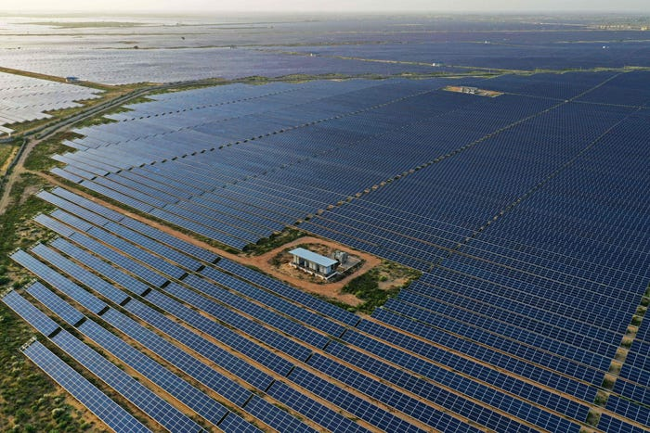
Java Lab Project
Semester: IV Batch: 2023-27
AY 2024-25
Title: “Lifecycle Assessment (LCA) for Indian Solar Panel Arrays”
Group Members: Contribution:
Ameya Tipnis (23070126012) Team Lead, SQL Database Connectivity
Asho Shibu (23070126023) LCA calculation, Error Handling
Eric Siqueira (23070126041) PPT, Devised Initial Code & Structure
Ron Matthew (23070126109) Subsidy Data Collection

Slide 2
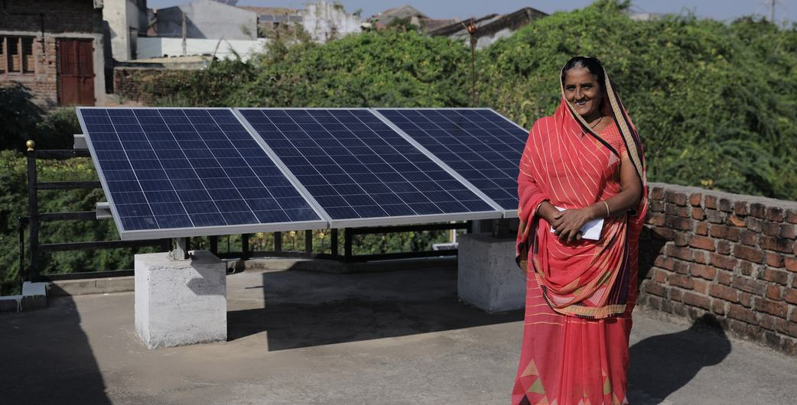
Introduction:
What problems are we aiming to solve for the average Indian?
1. Assessing the true environmental and economic impact of solar panel installations in India is a complex task due to varied regional subsidies and geographic conditions.
2. India lacks a dynamic tool for calculating the return on investment (ROI) and environmental footprint of solar panels that accounts for location-specific factors in India.
3. We lack the User-Awareness by Indian consumers and businesses for making informed decisions about solar panel installations.

Slide 3

Project Objectives:
Primary Objectives:
Developing a Java application to accurately calculate the lifecycle assessment(LCA) for developing and maintaining solar panel installations across India.
Integrate a database to store and retrieve regional solar subsidy data provided by various local and state governmental bodies, ensuring accurate ROI calculations.
Create a user-friendly interface that simplifies complex maintenance and cost calculations for users.
Secondary Objectives:
Enable users to input specific parameters such as panel type, system size, and location to personalize the assessment.
Ensure the application is scalable and maintainable, allowing for future updates and enhancements.
Promote awareness and adoption of solar energy in India through an accessible and informative tool focusing on localised data.

Slide 4
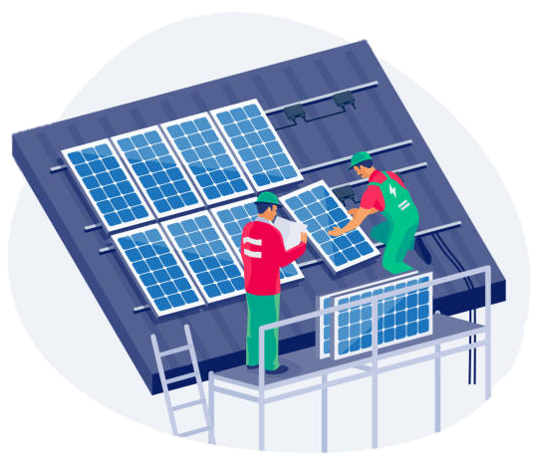
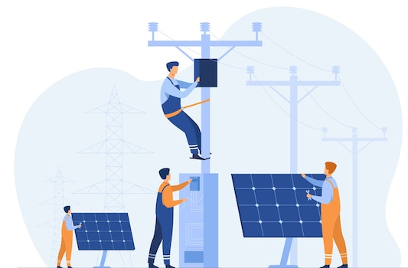
OOPs Implementation:
1. Encapsulation
The `DatabaseHelper.java` encapsulates database operations.
`SolarCostCalculator.java` encapsulates panel selection and calculation logic.
Static methods `getLatestPanelEfficiency()` and `getLatestPanelArea()` provide controlled database access to panel data.
Private helper methods hide implementation details, ensuring code security.
2. Class Abstraction
Each class represents a specific domain concept.
`DatabaseHelper.java` abstracts the SQL database interactions.
`OptimalPanelLayout` inner class captures layout calculations.

Slide 5
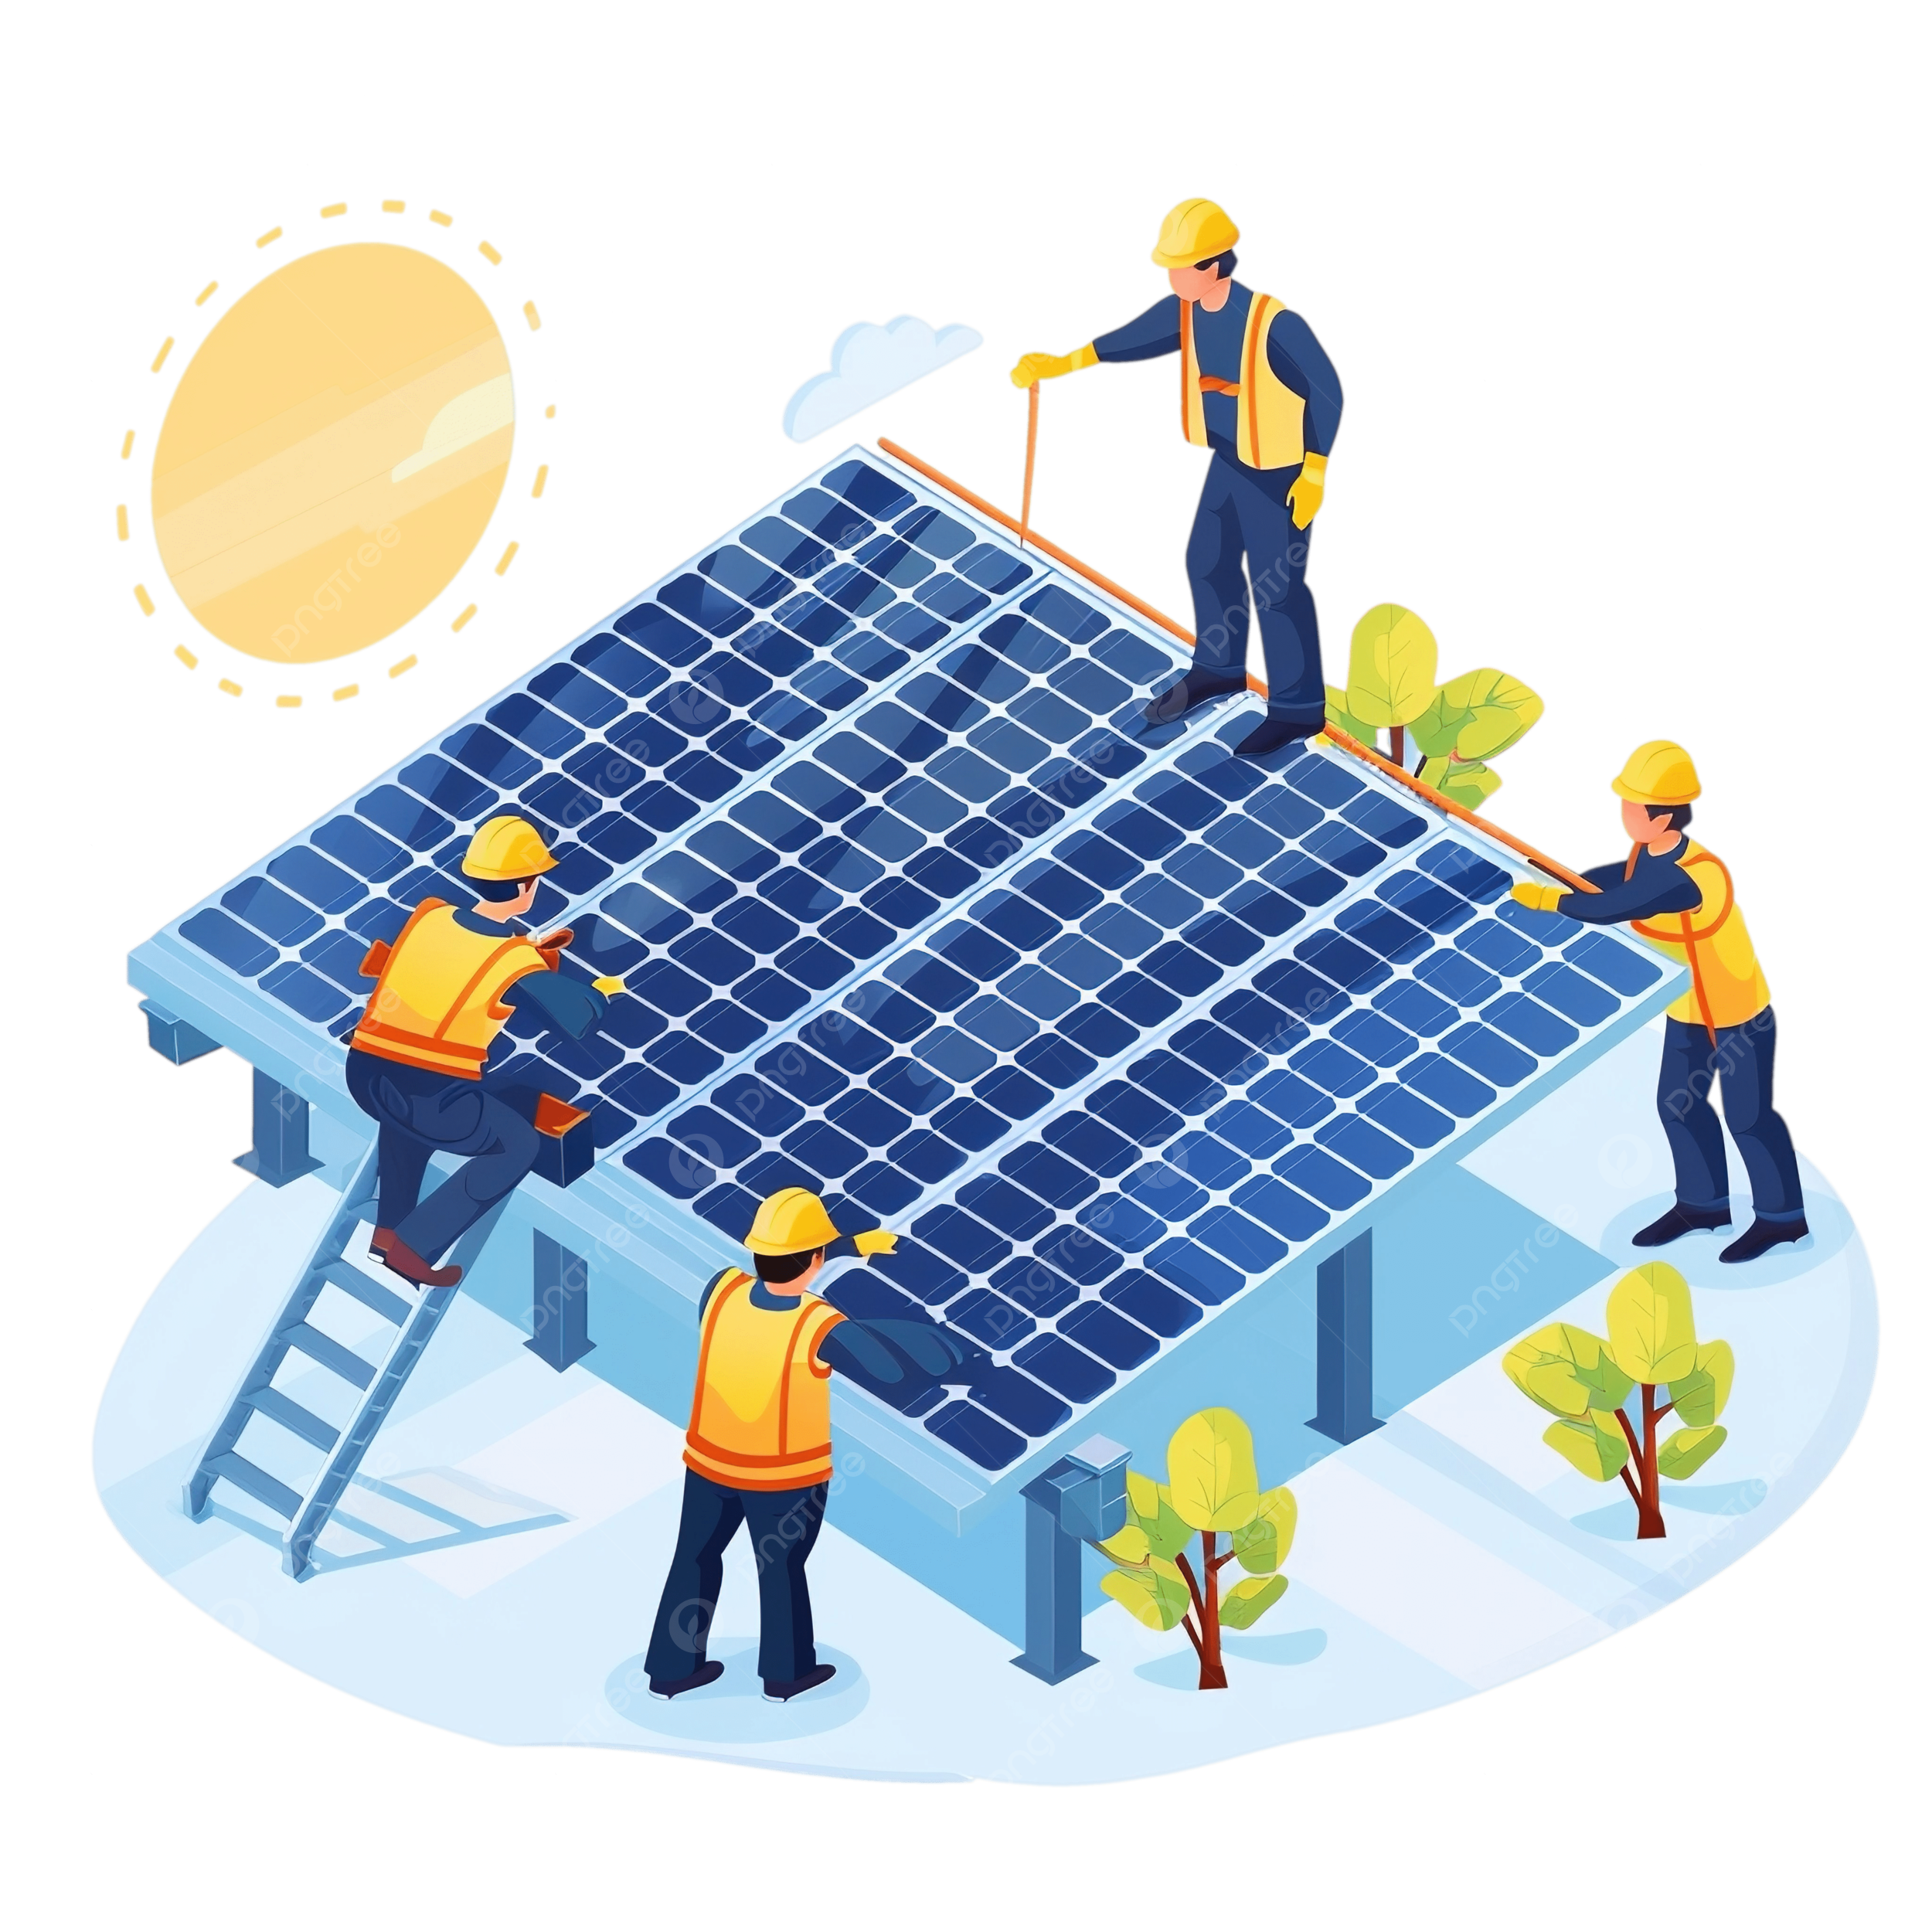
OOPs Implementation:
3. Data Flow:
User input → Database queries → Calculations → Output display
Calculations are drawn from both user input and database values.
4. Relationships In Classes:
Composition: `SolarCostCalculator.java` contains an inner class `OptimalPanelLayout`.
Dependency: All application classes depend on `DatabaseHelper.java`.
Shared State: Panel data selected in one class affects calculations in others.

Slide 6

Implementation of Java Components:
Database Implementation:
As a robust database layer, we centered the project around the ‘DatabaseHelper.java’ class.
This manages all database operations, providing a clean interface between the application logic and the underlying MySQL database.
Database Connection Management:
Implemented JDBC to connect to a MySQL database. Connection parameters (URL, username, password) are stored as constant values.
getConnection() method provides a standardized way to obtain database connections for the application.
Query Execution Method:
We have developed methods for retrieving different data sets (projects, agreements, panel data, etc.). Parameterized queries are used where appropriate to prevent SQL injection.

Slide 7
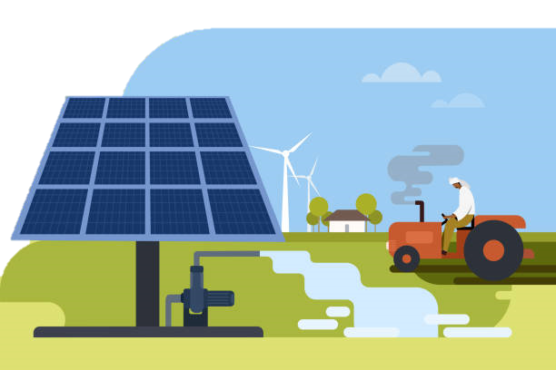
Implementation of Java Components:
Resource Management:
Used try-catch-finally to ensure proper cleanup of database resources.
Exception Handling Framework:
JDBC Exception Handling: Possible SQL exceptions are caught at appropriate levels. The application uses a combination of:
Exception propagation (throwing SQLException).
Local exception handling with stack trace printing.
Error Reporting & Logging:
Database errors include descriptive messages and stack traces for debugging. Different error indicators are used to visually distinguish error types.

Slide 8
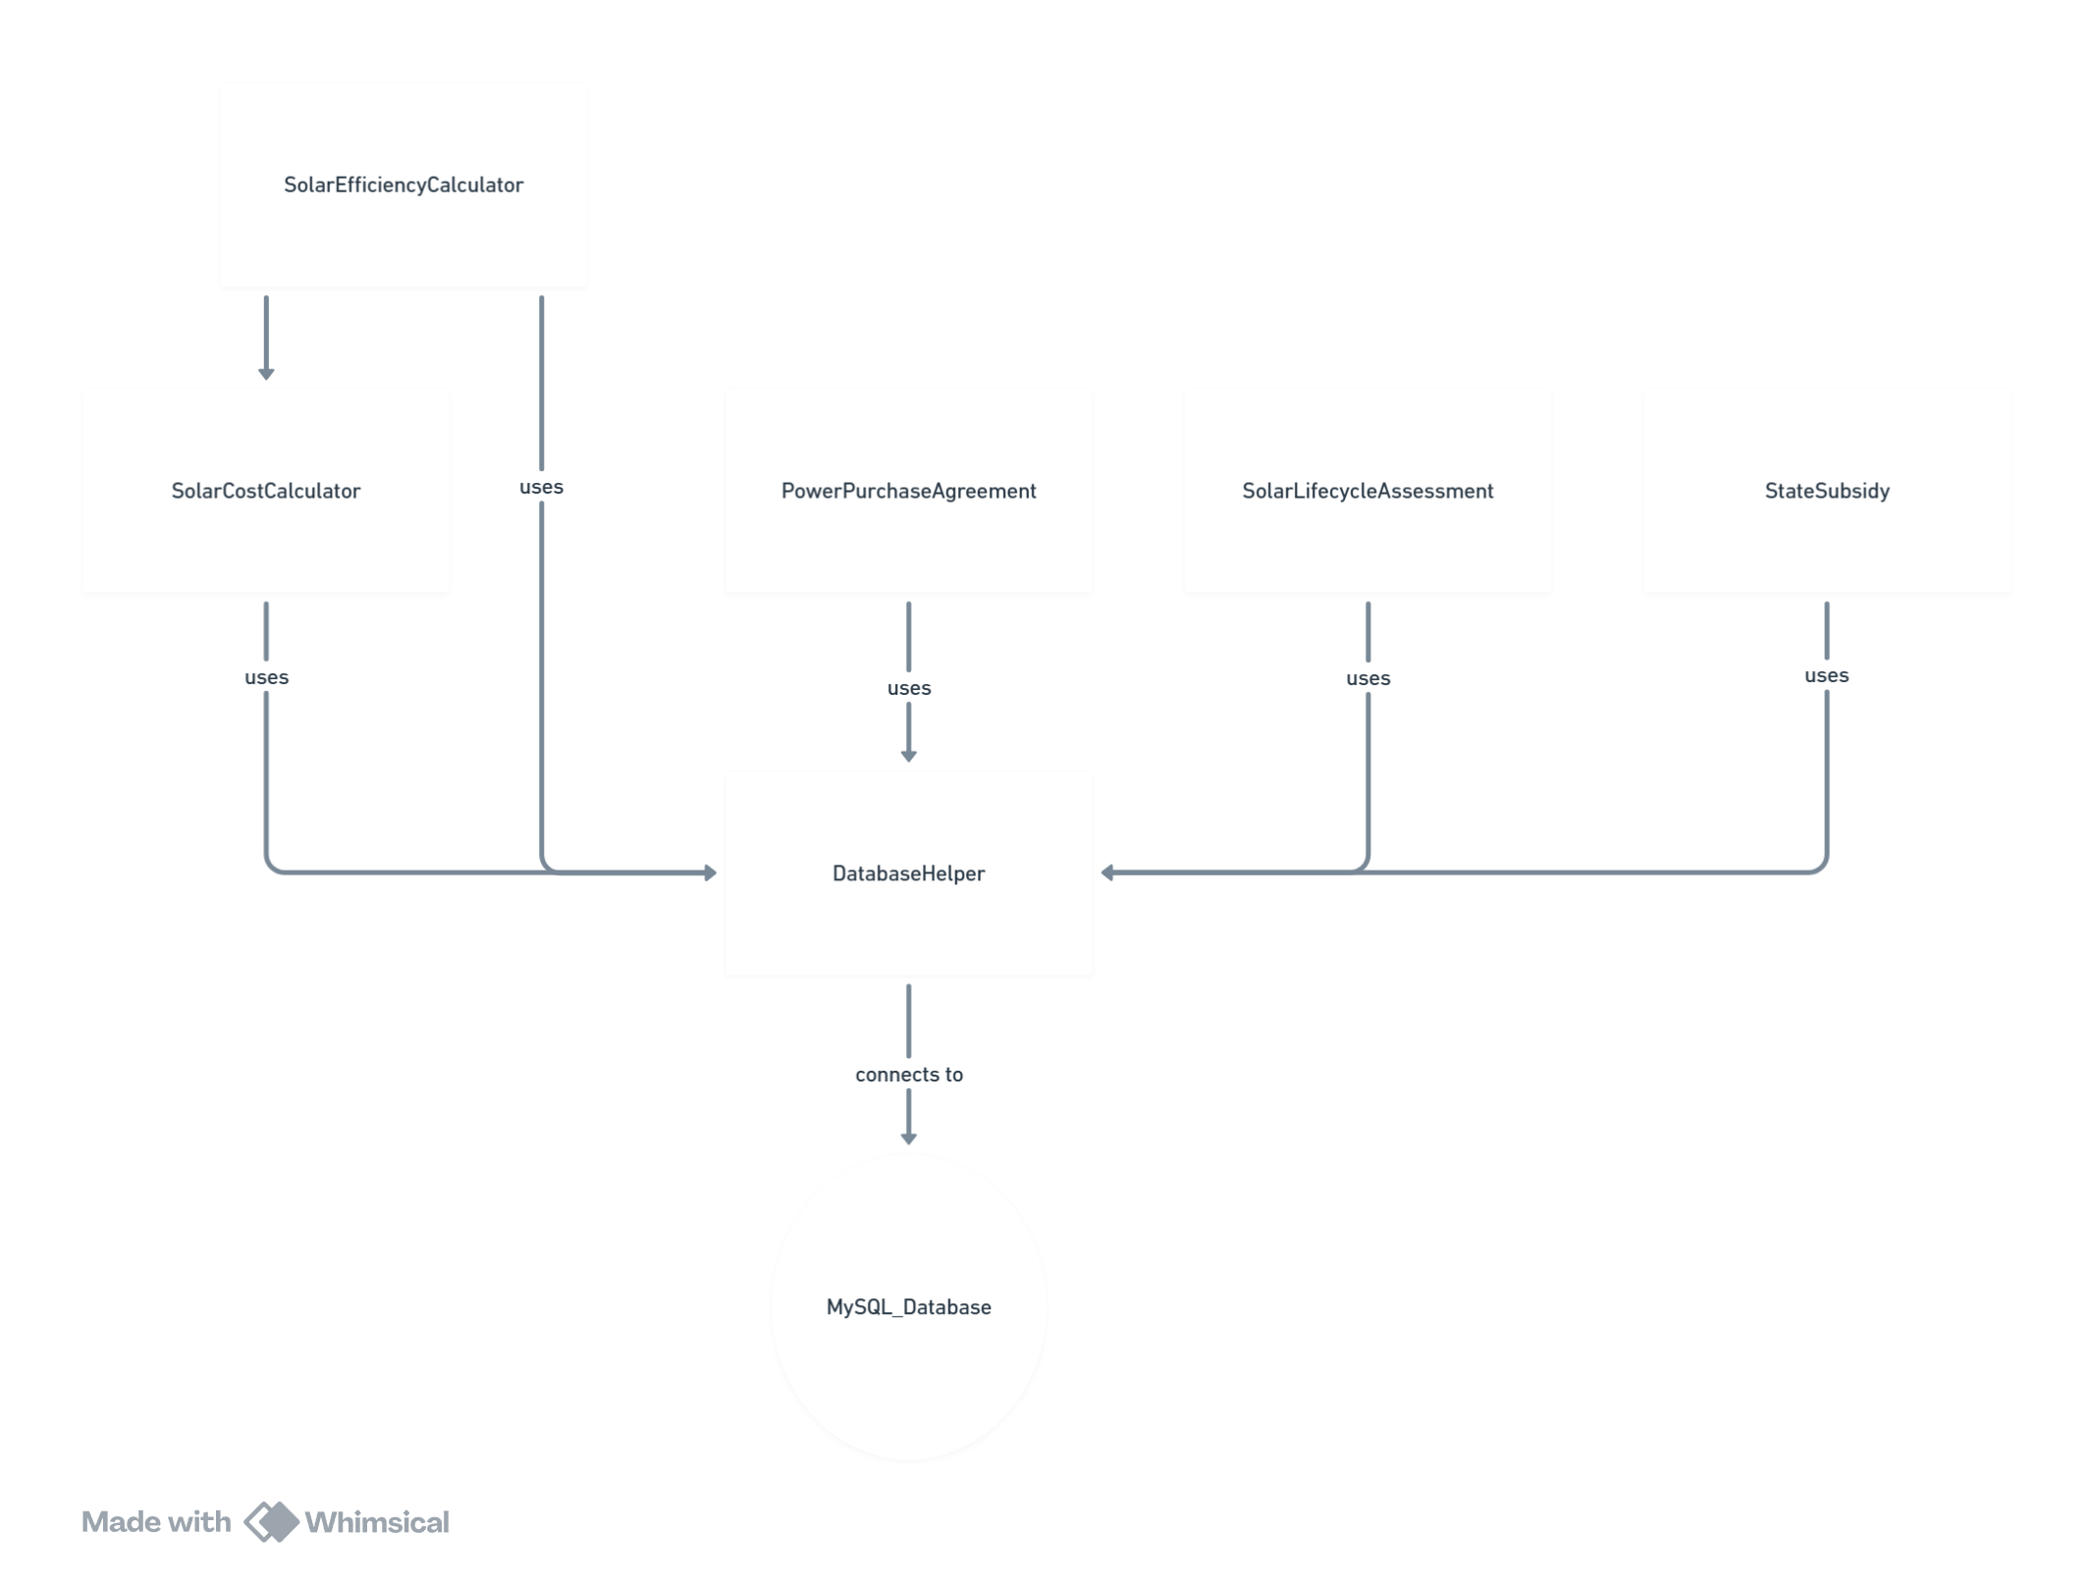
Moving forward…
Frontend Interface Development:
Using React with a Java REST API to create a seamless interface for taking user inputs. This is focusing on separating business logic from UI.
Additions include; an interactive panel layout visualizer, calculation dashboard, and form-based data entry.
Threading Implementation:
Implement threading to perform multiple solar array calculations concurrently, significantly improving processing time.
Web Deployment:
Migrate the database from local MySQL to a cloud-based solution with proper connection pooling for reliability.

Slide 9
calculateEfficiencyFactor(double) double
getLatestPanelData() double[]
Flowchart:
Flowchart
double latestPanelEfficiency
double latestPanelArea
setLatestPanelData(double, double)
getLatestPanelEfficiency()
getLatestPanelArea()
calculateAndStorePanelEfficiency(int)
displaySolarPanelModels()
calculateOptimalLayout(double, double, int)
String URL
String USER
String PASSWORD
getConnection()
getProjects()
getPowerPurchaseAgreements()
getSolarPanelData()
getStateSubsidies()
getSolarIntensity()
getSolarPanelModels()
getSunlightHours(String, String)
getStateSubsidyByState(String)
executeQuery(String)

Slide 10
References:
Key Sources:
State-Wise Renewable Energy Settlement Rates In India: A Comparative Analysis - Report - SolarQuarter
Statewise Rooftop Solar Policies in India- MYSUN (itsmysun.com)
https://prefuelenergy.com/solar-panel-prices-in-india-with-subsidy/
https://waaree.com/wp-content/uploads/2024/10/13.Final-Report_Solar-Power-Market-in-India_Part-2.pdf
https://www.ceew.in/sites/default/files/rooftop-solar-deployment.pdf
https://www.cif.org/sites/cif_enc/files/rooftop_solar_pv_in_india_ctf_pwc._v8pdf_0.pdf
https://ieefa.org/sites/default/files/2022-10/Indian%20Residential%20Rooftops-%20A%20vast%20Trove%20of%20Solar%20Energy%20Potential_Oct2022.pdf
https://doi.org/10.1016/j.csite.2021.101010
https://climatepolicyinitiative.org/wp-content/uploads/2018/02/Scaling-up-Rooftop-Solar-Power-in-India-The-Potential-of-Solar-Municipal-Bonds.pdf
https://pmsg-production-public.s3.ap-south-1.amazonaws.com/download/7_NPTI_Discom_Employees_English.pdf
https://www.reuters.com/business/energy/skills-shortage-hobbles-indias-clean-energy-aspirations-2024-11-20/
https://en.wikipedia.org/wiki/Net_metering
https://en.wikipedia.org/wiki/Solar_power_in_India
https://distributedenergy.medium.com/indias-state-wise-solar-energy-policies-b99799852664
https://www.livemint.com/news/india/india-installs-400-000-rooftop-solar-units-under-pm-s-free-electricity-scheme-11729089461564.html
https://www.moglix.com/luminous-380w-perc-monocrystalline-solar-panel/mp/msn858078enl92?srsltid=AfmBOoo7dKlA-DeP_vjRZyly02-Y-HVe5oR_1JS3lcHpAPumjR7mIwwa&utm
https://www.moglix.com/luminous-380w-perc-monocrystalline-solar-panel/mp/msn858078enl92?srsltid=AfmBOoo7dKlA-DeP_vjRZyly02-Y-HVe5oR_1JS3lcHpAPumjR7mIwwa&utm
https://www.solarfeeds.com/product/tp300-series-288-300

Slide 11
References:
Data Entries Link: https://docs.google.com/document/d/1IkJAZFxw3V6Mty8HbrEU30n4OwTKjU9a/edit?usp=sharing&ouid=112033620501447592381&rtpof=true&sd=true
Github Codes and Packages Used:
https://github.com/EricSiq/JavaProject-Lifecycle-Assessment-of-Solar-Arrays

Slide 12
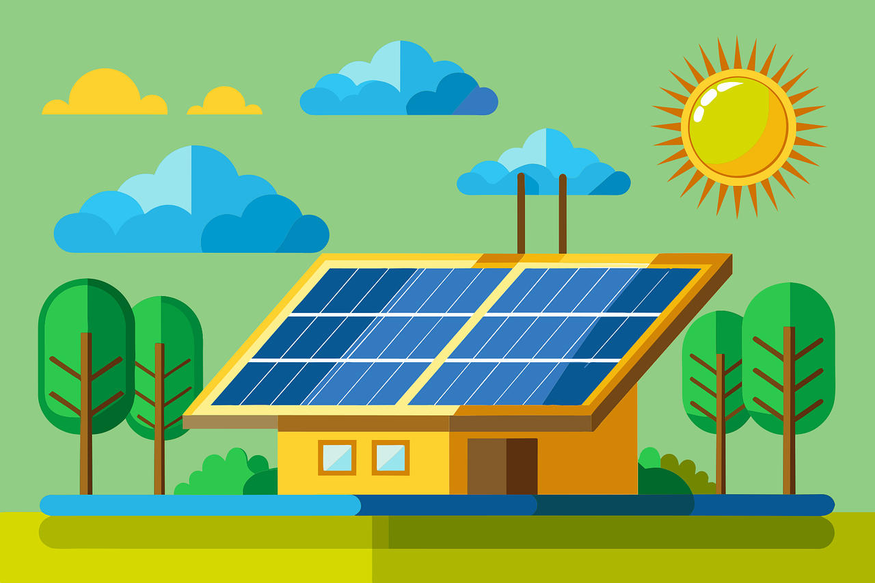

Thank You

